Slide 1

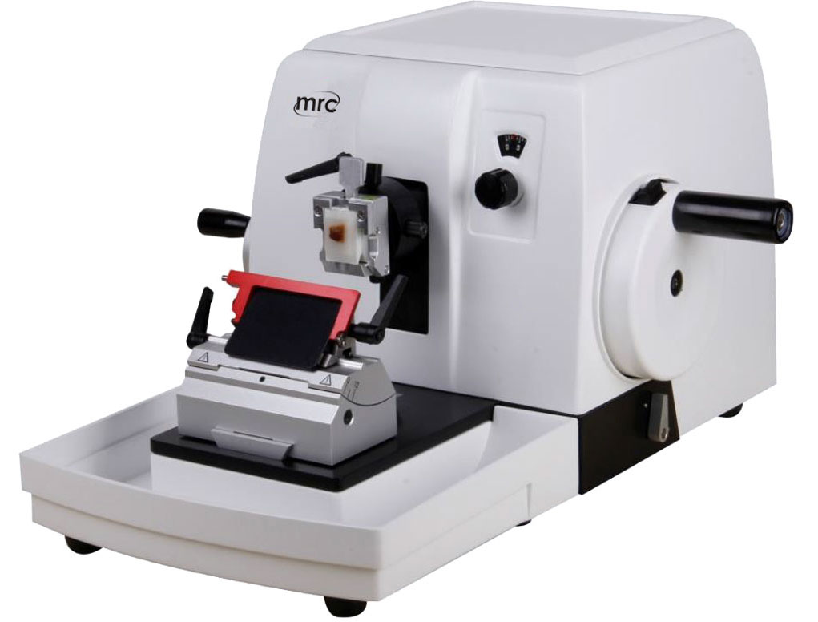
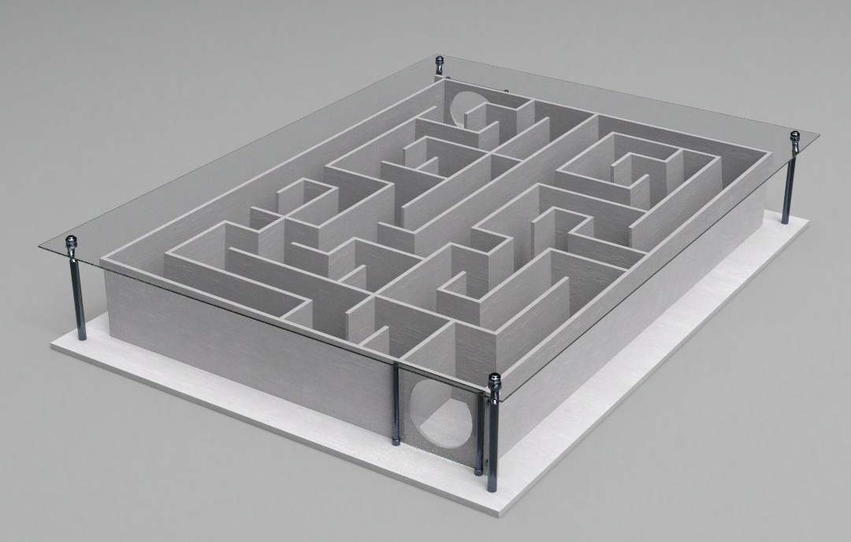
DEPARTMENT OF ZOOLOGY
CONSULTANCY SERVICES
ROTARY MICROTOME
Glass Rat maze
A Rotary Microtome is a common assistive instrument used in pathology for paraffin embedding histological technique applied in preparing tissue sections.
It is use for studying, observing and determining the morphological changes of cellular tissues of plants and animals, immunohistochemistry, immunofluorescence, genome sequencing, etc.
A maze is a collection of paths connected through one or multiple choice points, typically leading to one goal location.
This instrument is used to study spatial learning, memory and navigation in rats and rodents.

Slide 2
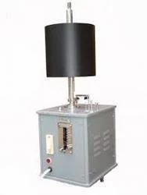
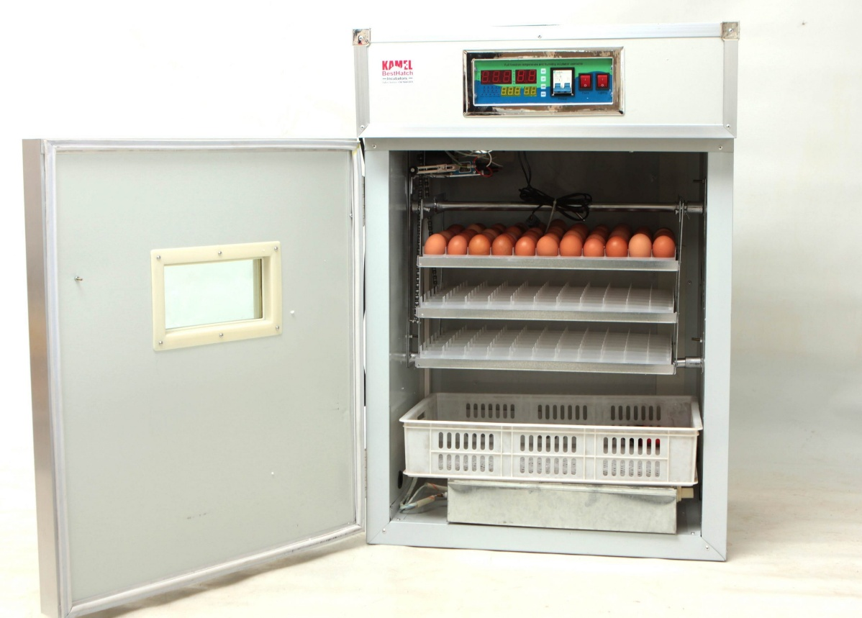
DEPARTMENT OF ZOOLOGY
CONSULTANCY SERVICES
Automatic Egg Rotating Incubator
Kymograph
This egg incubator is fully automatic with electricity, it can keep temperature within 6 hours blackout. Automatic egg turner, it will turn every two hours.
High and low temperature alarm, high and low humidity alarm. It is suitable for the farmers and specialized households to incubate chickens, ducks and geese etc.
A kymograph is a type of two-dimensional plot and also an analog device that draws a graphical representation of spatial position over time. The graphical representation is a graph in which the y axis shows position and the x axis shows time. the kymograph has been used most commonly in the field of medicine to study various physiological and muscular processes, for example blood pressure, respiration and muscle contractions. Kymographs were also used outside medical science to measure atmospheric pressure, speech sounds tuning fork vibrations, the functioning of steam engines, animal habits, and the movement of molecules in cells.

